Slide 1

JRE JVM

Slide 2
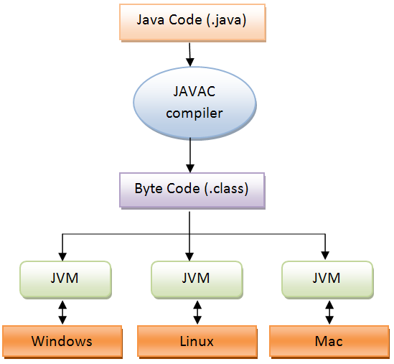
JDK JRE JVM

Slide 3
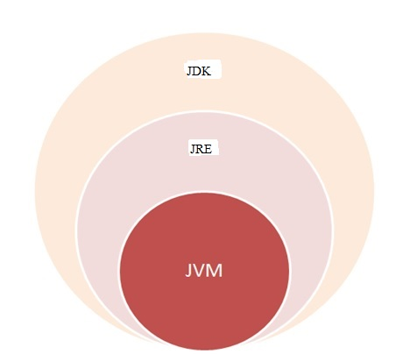
JDK JRE JVM

Slide 4
JDK JRE JVM
JDK
Java Development Kit
JRE
Java Runtime Environment
JVM
Java Virtual Machine
Notes:
JRE – Java Runtime Environment
JDK – Java Development Kit
JVM – Java Virtual Machine

Slide 5
JAVA VIRTUAL MACHINE
A Java virtual machine (JVM) is a process virtual machine that can execute Java byte code.
It is the code execution component of the Java platform.
JVM
FEATURES
Although the JVM was primarily aimed at running compiled Java programs, many other languages can now run on top of it.
The JVM verifies all byte code before it is executed.
Notes:
A Java virtual machine (JVM) is a process virtual machine that can execute Java byte code.
It is the code execution component of the Java platform.
Although the JVM was primarily aimed at running compiled Java programs, many other languages can now run on top of it.
The JVM verifies all byte code before it is executed.

Slide 6
IDE
NetBeans
Eclipse
Jcreator
Processing
Components
BlueJ
MyEclipse
JDeveloper
Notes:
NetBeans
Eclipse
Jcreator
Processing
BlueJ
MyEclipse
JDeveloper

Slide 7
THE WAY JAVA WORKS
Create a source document. Use an established protocol.
Run your document through a source code complier. The complier checks for errors and won't let you compile Until it's satisfied that everything will run Correctly.
The compiler creates a new document, coded into Java bytecode. Any device capable of running Java will be able to Interpret/translate this file into something It can run.
The complied bytecode is platform Independent.
.
Your friends don't have a physical Java Machine, but they all have a virtual Java machine (implemented In software) running inside their electronic gadgets. The virtual machine reads and runs the bytecode.
Notes:
Create a source document. Use an established protocol.
Run your document through a source code complier. The complier checks for errors and won't let you compile Until it's satisfied that everything will run Correctly.
The compiler creates a new document, coded into Java bytecode. Any device capable of running Java will be able to Interpret/translate this file into something It can run.
The complied bytecode is platform Independent.
Your friends don't have a physical Java Machine, but they all have a virtual Java machine (implemented In software) running inside their electronic gadgets. The virtual machine reads and runs the bytecode.

